Slide 1
Proposal of optimizing supply chain efficiency through predictive analytics: a data-driven approach
Cai Fuyuan
MCS231005
25/07/2024

Slide 2
Chapter 1: Introduction
Chapter 2: Literature Review
Chapter 3: Methodology
Chapter 4: Initial Results
Chapter 5: Discussion and Future Work

Slide 3

Chapter 1: Introduction
What is Supply Chain?
is a complex logistics system that consists of facilities that convert raw materials into finished products and distribute them to end consumers or end customers. Meanwhile, supply chain management deals with the flow of goods within the supply chain in the most efficient manner.
Supply chain diagram. Black arrows indicate material and information flows and gray arrows indicate information and backhaul flows. Elements include (a) initial supplier (vendor or factory), (b) supplier, (c) manufacturer (production), (d) customer, and (e) final customer.

Slide 4
Chapter 1: Introduction
In the contemporary business environment of rapid technological development and fierce market competition, the efficiency of actual supply chain operations has become one of the key influencing factors in determining the success or failure of business organizations, which must optimize their supply chain operations in order to maintain their competitive advantage.
Traditional supply chain management approaches, which typically rely on reactive measures and historical data consolidation, often fail to address the complexity and dynamics of modern supply chain systems. These traditional approaches struggle to provide the flexibility and foresight needed to navigate the volatile demands and unexpected disruptions of today's markets.

Slide 5
Chapter 1: Introduction
Predictive analytics, an innovative approach that uses advanced algorithms and machine learning techniques to analyze historical data and predict future trends, offers a promising solution to these challenges. By anticipating future demand, identifying potential bottlenecks and optimizing resources across the supply chain, predictive analytics enables companies to make proactive, data-driven decisions. This shift from reactive to proactive supply chain management not only improves operational efficiency, but also provides a significant competitive advantage.

Slide 6
Chapter 1: Introduction
Background to the issue
One of the biggest challenges in supply chain management is accurately forecasting customer demand. Traditional forecasting methods often rely heavily on historical sales data that may not reflect rapid changes in market conditions, consumer behavior or economic fluctuations. This can lead to excess inventory, which increases holding costs and ties up capital, or to out-of-stocks, which can result in lost sales and decreased customer satisfaction.
(1) Increasing complexity
(2) Fluctuating demand
(3) Inventory challenges
(4) Operational inefficiencies
(5) Supply chain disruptions
(6) Inadequate data utilization

Slide 7
Chapter 1: Introduction
Research Questions
(1) How can predictive analytics improve the accuracy of demand forecasting in supply chain management?
(2) How can customer segmentation using predictive analytics improve supply chain efficiency and customer satisfaction?
(3) How does predictive analytics affect inventory optimization and cost reduction in supply chains?
(4) What are the key factors affecting the effectiveness of forecasting models in supply chain optimization?
Notes:
Big data is an essential asset that needs to be processed and analyzed in order to extract knowledge. This knowledge can then be used to enhance decision-making and save expenses. Only relying on human intelligence is insufficient for accurate diagnosis. The diagnosing process will involve numerous challenges.

Slide 8
Chapter 1: Introduction
Objective of the study
This study is to improve supply chain efficiency by using predictive analytics to forecast demand, optimize inventory levels and improve overall operational efficiency. Specific objectives include:
(1) Demand forecasting: using historical sales data to forecast future product demand.
(2) Inventory Optimization: Determine optimal inventory levels to reduce costs and prevent stock-outs or overstocking.
(3) Supplier performance analysis: Evaluate supplier performance to identify potential improvements and reduce risk.
(4) Customer Satisfaction Improvement: Analyze customer satisfaction data to identify trends and improve service quality.

Slide 9
Chapter 1: Introduction
Scope of the study
(1) Data collection and integration
Data source: dataset in Github https://github.com/drshahizan/dataset/tree/main/mongodb/01-sales
(2) Demand forecasting
Analyze historical sales data to identify trends and patterns.
Develop and compare various forecasting models (e.g. ARIMA, machine learning algorithms) to predict future demand.
Evaluate the accuracy and reliability of these models in different scenarios.
(3) Supply Chain Stages
Inventory optimization, customer insights, logistics optimization
(4) Model Evaluation and Validation

Slide 10
Chapter 2: Literature Review
Related focuses on various aspects of supply chain management, including:
(1) Demand forecasting techniques
(2) Inventory optimization
(3) Customer insights
(4) Logistics optimization
While the benefits of predictive analytics in supply chain management are clear, a number of challenges remain. The implementation of predictive models requires significant data integration, computational resources, and expertise. In addition, the dynamic nature of the supply chain requires continuous model updates and real-time data processing. Future research should focus on integrating real-time data sources, such as IoT devices and social media, to improve prediction accuracy. Exploring advanced machine learning techniques such as deep learning and reinforcement learning could also provide more powerful solutions for supply chain optimization.

Slide 11
Chapter 3: Methodology
Research design and data cleaning
This study used quantitative research design to analyze the figures and data visualization to derive results to give recommendations. Specific methods include descriptive statistics, predictive modeling and machine learning techniques.
Data cleaning: data were imported and cleaned to ensure accuracy and completeness, resolving missing values, inconsistencies and outliers, standardizing date formats and ensuring consistency of categorical data, and creating relevant variables for analysis.

Slide 12
Chapter 3: Methodology
Exploratory Data Analysis
Descriptive statistics:
Calculate metrics such as mean, median, standard deviation, and distribution for key variables (e.g., sales, volume, customer satisfaction) using Python libraries such as Pandas and NumPy.
Visualization:
Use histograms, bar charts, and box-and-line plots using Matplotlib and Seaborn to visualize other key metrics such as sales trends, seasonal patterns, product popularity, and customer demographics.
Correlation analysis:
Use Pearson's correlation coefficient to identify relationships between variables such as sales volume, customer satisfaction, and buying patterns to inform predictive models.

Slide 13
Chapter 3: Methodology
Predictive model
(1) Demand Forecasting: Time series analysis using ARIMA and exponential smoothing models to forecast future sales based on historical data. These analyses are performed using Python's tatsmodels library.
(2) Inventory optimization: Machine learning algorithms such as Random Forest and XGBoost are applied to recommend optimal inventory levels and reorder points. Scikit-learn and XGBoost libraries are used.
(3) Customer Segmentation : Cluster analysis using K-means or hierarchical clustering to develop customer segmentation models by clustering customers based on purchase behavior and demographics.

Slide 14
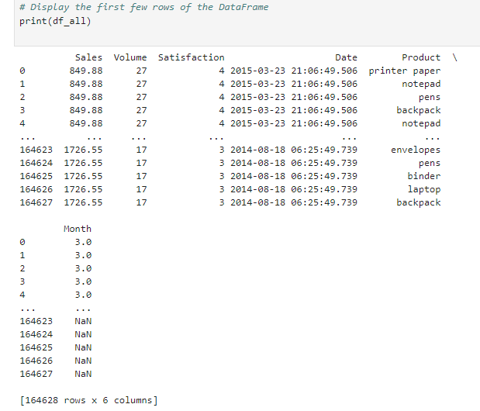
Chapter 4: Initial Results
Descriptive Statistics
By loading the dataset, it shows that the dataset has 6 columns and 164628 rows, and the data includes Sales, Volume, Satisfaction, Date, and Product, which belongs to a large database and is sufficient to support the data analysis in this paper.

Slide 15
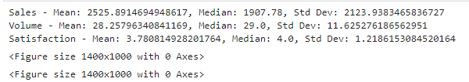
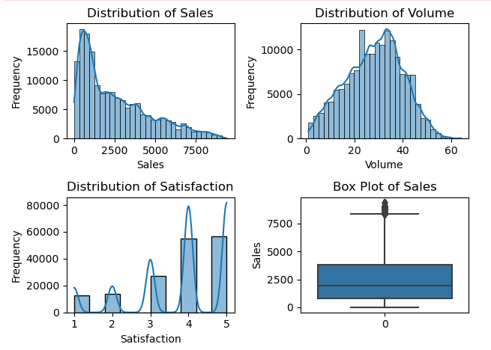
Chapter 4: EDA/Initial Results
After simple data processing, the mean, median, standard deviation, and distribution of some key variables (e.g., sales, volume, customer satisfaction) were first calculated. The run was very smooth, confirming that the dataset was of good quality.

Slide 16
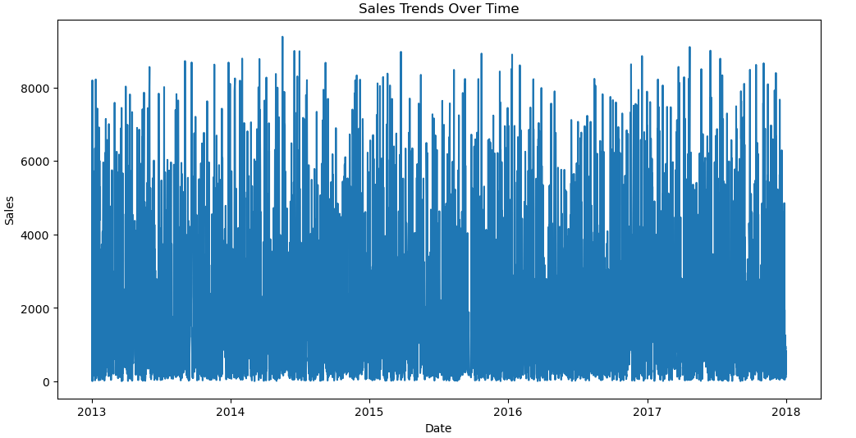
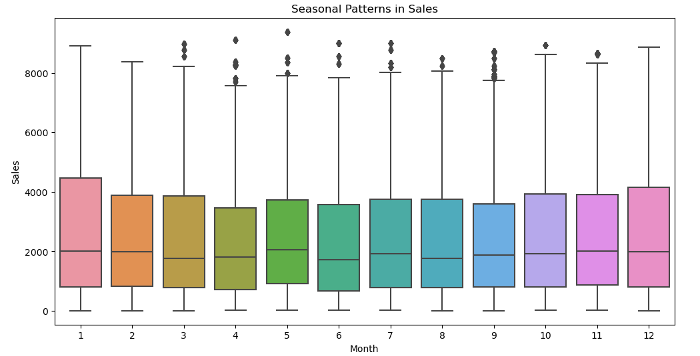
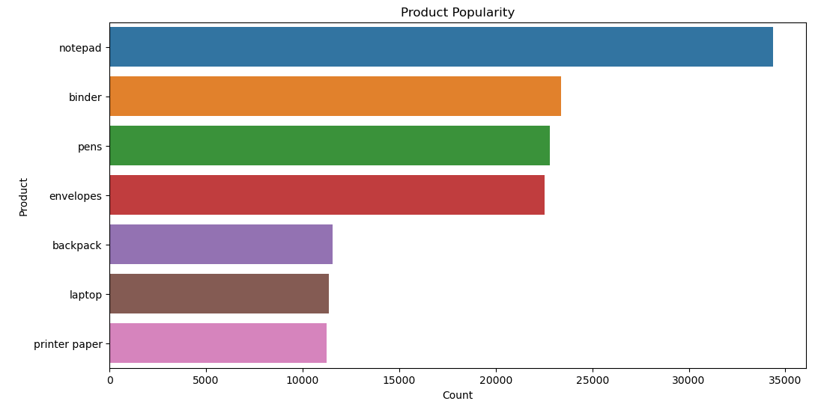
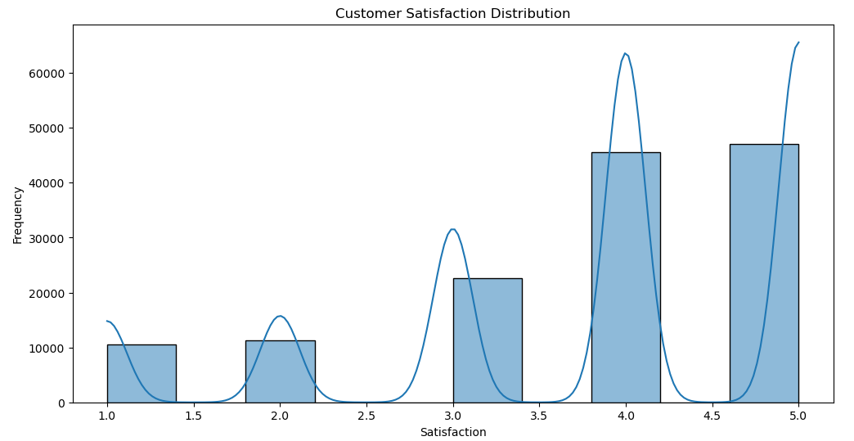
Chapter 4: EDA/Initial Results
Visualization
Initial testing used histograms, bar charts, and box-and-line graphs to visualize other key metrics such as sales trends, seasonal patterns, product popularity, and customer demographics.

Slide 17
Chapter 5: Discussion and Future Work
Interpretation of the results of predictive analytics and assessment of their impact on supply chain efficiency. Recommendations for implementing data-driven strategies in inventory management, demand forecasting, and logistics. Recommendations for integrating real-time data sources (e.g., IoT, social media) to improve forecast accuracy. Explore advanced machine learning techniques (e.g., deep learning, reinforcement learning) for further optimization. Plans to continuously monitor and update forecasting models to adapt to changing market conditions.

Slide 18
Thank You

